Slide 1

Alexa for Good
LESSON 1
How can you use technology to make the world a better place?

Slide 2
Teacher notes
Introduction
This 50-minute lesson provides an engaging, real-world context for exploring AI. Exploring computational thinking and how this can help solve real-world problems, students consider how this could be applied in their own environment by developing specific skills for Alexa.
Students then consider the specific elements required to code a skill for Alexa.
Age
13–18 (Key Stages 3–5, S3–S6)
Timing
50 minutes
Resources
Slides
Printable activity sheets
Preparation
Review the slides and activity sheets and identify which elements you will use.
Print copies of the activity sheets, if required.
Consider any optional activities and additional
resources required (see slide notes).
2

Slide 3
Teacher notes
Lesson Objectives
Give a definition for artificial intelligence
Explain how a voice assistant understands a command
Use a helpful thinking tool to solve a computational problem
Curriculum Links - Computing
Key Stage 3 – undertake creative projects that involve selecting, using, and combining multiple
applications, preferably across a range of devices,
to achieve challenging goals, including collecting and analysing data and meeting the needs of known users
Key Stage 4 - develop and apply their analytic, problem-solving, design, and computational
thinking skills
3

Slide 4
Deliver as a lesson – 55 mins
 | Activity | Time | Slides | Resources
Starter | What is AI and how does AI help us? | 5 mins | 6-7
Main activity 1 | How do we communicate with Alexa? | 15 mins | 8-11
Main activity 2 | How can we break down a problem for Alexa to solve? | 25 mins | 12-15 | ‘Malia Recycles’ activity sheet
Plenary | Computational Thinking | 10 mins | 16-18 | ‘Malia Recycles’ activity sheet (optional)
4

Slide 5
Deliver as a STEM club activity – 2 x 40 mins
 | Activity | Time | Slides | Resources
Starter | What is AI and how does AI help us? STEM extension activity | 5 mins 20 mins | 6-7 | ‘STEM Club’ activity sheet (optional)
Main activity 1 | How do we communicate with Alexa? | 15 mins | 8-11
Main activity 2 | Reminder – how to talk to Alexa How can we break down a problem for Alexa to solve? | 5 mins 25 mins | 10-11 12-15 | ‘Malia Recycles’ activity sheet
Plenary | Computational Thinking | 10 mins | 16-18 | ‘Malia Recycles’ activity sheet (optional)
5

Slide 6
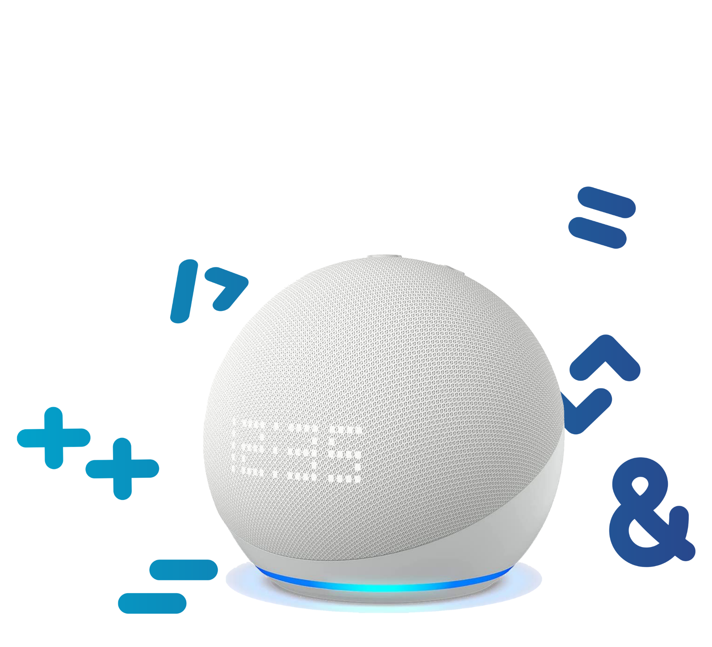

Learning outcomes
You’ll be able to:
Give a definition for artificial intelligence
Explain how a voice assistant understands a command
Use a helpful thinking tool to solve a computational problem
6

Slide 7


What is AI and how does AI help us?
AI stands for Artificial Intelligence.
Intelligence means to be able to learn and apply knowledge or skills.
What do you think AI describes?
Can you think of any examples of AI you might already use?
How does AI help us to do things better?
7
Notes:
Starter activity
Students can use sheets of paper or an online tool to record their ideas as concept maps.
Introduce AI and review the simple definition of intelligence. Our intelligence means we can learn new things and then apply them, for example, to solve a problem we’ve not encountered before.
With this in mind, ask students to explain what they think AI means or describes – what exactly do they think sets AI apart from other computer programs?
Share ideas and examples (there are some on the next slide). Use students’ examples to highlight how AI often helps us to do things better – it can take away some of the work and solve problems for us that otherwise might be difficult or time-consuming.

Slide 8



AI is a program that can learn
Artificial Intelligence (AI) is when a computer program is able to learn from rules and patterns it detects in data, rather than just follow instructions.
AI programs can help us by:
Improving how navigation apps guide us from place to place
Learning what music or movies we like most
Identifying potential fraud, to keep our banking safe
Helping to make faster and more accurate medical diagnoses
Powering voice assistants on phones and in homes.
8
Notes:
Main Activity 1
Share the definition of AI. Discuss how students think this helps AI to be different (and better) to ‘normal’ computer programs.
The answer is that a computer program will only ever be able to do what we have programmed it to do. AI is able to solve problems it’s not encountered before by applying rules in new ways or by identifying patterns in the data it receives. In a way, an AI program has a kind of ‘initiative’ – it can solve new problems without being asked (programmed) to do so. For example, the AI that helps a navigation app will find the fastest or shortest route to follow, even if it’s not been asked to navigate that journey before, by understanding patterns in traffic data from similar roads and computing how they predict traffic might flow along possible routes.
Review the examples of AI and how they make life better in small or sometimes large and important ways.

Slide 9
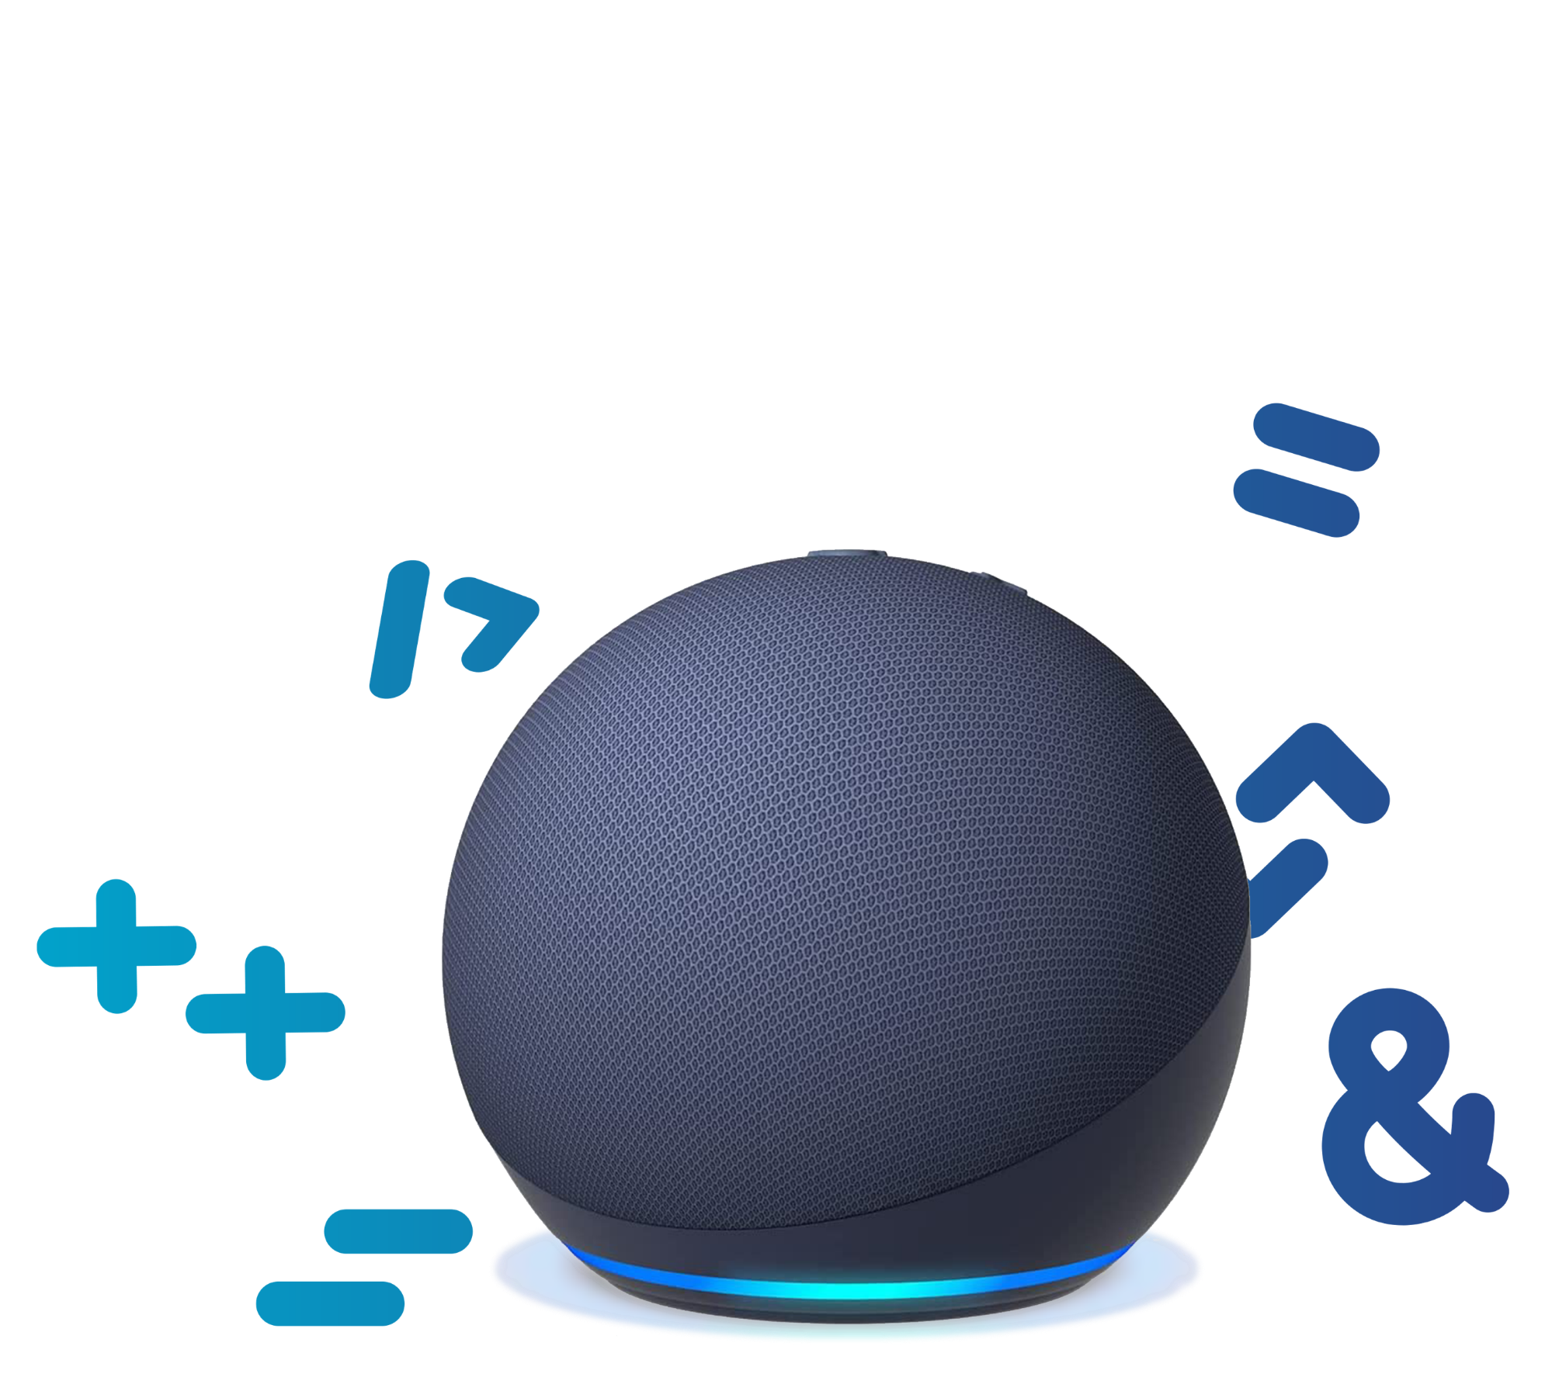
Introducing Alexa
Alexa is a voice assistant that uses AI to solve problems and make people’s lives easier.
Alexa can carry out tasks or find answers.
What do you think Alexa needs to learn in order to help?
What patterns might Alexa need to detect?
How do you think Alexa could make your life easier or better?
9
Notes:
Introduce Alexa.
Discuss what Alexa might need to learn. This might include our speech and the different words we prefer to use, but also our habits and preferences, like when we prefer to get up or our music and movie interests.
Alexa might detect patterns in what songs we like, when we ask reminders to be set and other day-to-day choices we make.
Ask students to share their ideas about how Alexa might make a person’s life easier or better. Students can complete as a Think-Pair-Share activity. Make sure to include all students and encourage those who may already have a voice assistant like Alexa at home to share general ideas and not just their own examples.

Slide 10
How do we communicate with computers?
When we communicate with another person we’re very good at understanding what they mean. We understand their intent.
When we communicate with computers we need to be:
Literal – use words in a standard way (use a programming language)
Precise – exact in what we mean (the code we write)
Alexa can understand what we say, even if we use different ways to ask Alexa to do something.
What do you think Alexa is programmed to ‘listen’ out for, to understand our intent?
10
Notes:
Link this discussion to students’ programming skills and experience of any programming languages or development environments.
Ask students to consider a friend or someone they know. How can they tell how that person is feeling? Discuss ideas.
Highlight that we can answer this question in lots of ways.
We could ask them directly and get a verbal reply.
But they may just give us a look or gesture which we’d also understand.
Or we might not even need to ask because we can tell by observing them.
We can pick up on lots of information that tells us the answer.
Ask students to consider the question: what is 2 + 3? How many ways could they ask someone that question so they would understand? There are lots of ways we could phrase it and make sense.
Contrast this with asking a computer (or even a calculator) the same question. We need to program our request using the correct operators and syntax so that the computer (or calculator) understands what we want it to do. (Older students could write a simple program in your preferred programming language or environment to do this.)
Ask students to identify what features of our language they think Alexa is able to identify and process in order to understand us. Students can discuss and share ideas verbally, or for a more structured approach, write examples on paper and label their ideas to identify the structures or phrases Alexa ‘looks’ for.

Slide 11
Alexa ‘listens’ for our intent
Alexa uses a natural language processing engine to understand our intent.
The skill name
The phrase used
to ask Alexa
The variable
Wake
word
Starting
phrase
Invocation
Utterance
Slot
Alexa,
ask
HomeworkHelper what I need to do tonight
Alexa, what homework do I need to do tonight?
We can program Alexa to recognise different utterances that all invoke the same intent.
The intent is what we program Alexa to do in response to our utterance.
Alexa, what’s my homework tonight?
Alexa, what’s tonight’s homework?
11
Notes:
Introduce an Alexa skill (a skill is like an app for Alexa) that could help a student remember what homework they need to do each night. Students might tell Alexa what work they have been given and when it is due, so HomeworkHelper can tell them what work is needed each night.
Explore the coloured phrase together to identify each element:
Wake word – This ‘primes’ Alexa to listen to what is said next.
Starting phrase or launch phrase – this tells Alexa what to do next.
Invocation – this tells Alexa what skill you want to use (to ‘invoke’ means to put something into action).
Utterance – this is the phrase you use to ask Alexa to do something. Alexa’s skill is to be able to respond to a range of utterances that the skill developer anticipates.
Slot – a specific variable or piece of information that Alexa needs in order to give a response.
Intent – this is what the Alexa skill is programmed to do.

Slide 12

How can we break down a problem for Alexa to solve?
Malia wants to remember which day is
recycling day (it’s every Tuesday).
A new Alexa skill could remind Malia if it’s recycling
day tomorrow and if not, to put her recycling in the
right bin.
She’ll call it Recycling Day.
What is Malia’s intent?
How can we break this problem down into smaller parts to solve?
12
Notes:
Main Activity 2
The following slides take students through the process of using computational thinking to solve a problem. For now, don’t mention this – students will review the main steps in computational thinking after they have solved this computational problem.
Students should fill in the ‘Malia Recycles’ activity sheet for this and the next slides.
Introduce Malia, who wants to be more sustainable and recycle, but often forgets what day is recycling collection day. Malia has decided to create a new Alexa skill for herself.
Explain that the first step is to break the problem down into smaller steps. Malia needs to understand her intent – what exactly she wants the skill to do – and can then break this action down into smaller and more easily solved mini-problems.
Working alone or in pairs, ask students to clarify the intent for this Alexa skill and then suggest how it can be broken down into smaller steps or actions.

Slide 13

How can we focus on what matters?
What are the important parts of Malia’s problem?
What bits could Malia ignore?
What patterns can we spot?
Malia might use different utterances to ask Recycling Day if it’s recycling day tomorrow.
What patterns will help Malia to list the utterances she might use?
13
Notes:
Explain that most problems include aspects that are important and things that don’t matter.
For example, if someone urgently needs to write a quick note, they need a pen but in this instance it might not matter what colour ink it contains.
Students consider if there are any bits of information or circumstances that Malia’s new Alexa skill needs to treat as important, and if there are any it can ignore.
Explain that understanding patterns helps to make simpler solutions to problems.
For example, a simple program could tell us that a number is even by dividing it by 2. We don’t need to tell the program to look for every individual even number, because there is a pattern the program can look for instead.
Remind students that Malia might use a range of utterances to ask whether it’s recycling day tomorrow. What patterns would they expect to see in these different ways of phrasing the question?

Slide 14
What step by step instructions fulfil
Malia’s intent?
Malia’s intent is that she will put her recycling bin out on Monday evening.
How exactly does Malia need Alexa to respond?
What information does Alexa need?
15
Notes:
Briefly review students’ progress. They have:
Identified the intent and broken this down into smaller steps
Worked out what’s important
Identified any patterns to look out for
The final step is to turn this into step by step instructions or rules – the algorithm they can program.
Students identify some step by step instructions Alexa could follow. (This just needs to be in plan text or simple pseudocode.)
Invite students to share their solutions to each step.

Slide 15
Introducing Recycling Day – a new Alexa skill
Break it down
Tell Alexa the day.
If it’s Monday, say to put out the recycling.
If it’s Tuesday, say to bring the recycling bin back in.
If it’s not Monday or Tuesday, say to put any recycling in the recycling bin.
What’s important?
Whether it’s Monday or Tuesday.
What doesn’t matter?
Whether it’s Thursday,
Sunday, etc.
Patterns
Malia might use different
utterances, like:
It’s Monday. Should I put out the recycling today?
Today is Tuesday. Is it recycling day today?
The most important pattern is
the word ‘recycling’.
Step by step
Listen for the day of the week.
If Monday, say ‘It’s tomorrow. Put the recycling out tonight’.
If Tuesday, say ‘It was today. Bring the recycling bin back in’.
Else say, ‘It’s not tomorrow, but remember to put your recycling in the bin’.
Decomposition
Abstraction
Pattern Recognition
Algorithmic Thinking
16
Notes:
Review these example solutions to each step in the process students have followed.

Slide 16

You’ve just used computational thinking
Computational thinking is a systematic, problem-solving approach that:
Breaks a problem down into smaller parts (decomposition)
Identifies the parts that are important (abstraction)
Spots any patterns or general features (pattern recognition)
Writes a step by step solution that a computer can carry out (algorithmic thinking).
Computational thinking can be applied to
any programming project or language.
17
Notes:
Plenary activity
Adapt your delivery to suit whether students are already familiar with computational thinking.
Emphasise that it’s a simple tool with a complicated name!
Computational thinking helps us to solve any computational problem (a task we want to program a computer to do for us), including programming a new Alexa Skill.
We can also use it to solve more everyday problems. Give each table a couple of minutes to discuss how they might use computational thinking to:
Starter: Boil an egg
Challenge: Choose what T-shirt to wear
More challenge: Find out what the weather will be later today
Finish by checking in with what students have learned. Students can use emojis or a RAG rating to review how well they can achieve each learning outcome. Ask students to identify:
One thing they have learned
One thing they would like to understand better
One thing they found interesting and would like to find out more about.

Slide 17

Alexa Young Innovator Challenge: solving real-world problems
There are many challenges in the world today, many of which still need solving.
Computational thinking and technologies like AI can help
us create solutions.
Think about how you could use Alexa to solve a problem that affects
people in your community.
What are the challenges in your home, school or local community?
How could Alexa be used to solve them?
18
Notes:
Introduce the Alexa Young Innovator Challenge
The process of creating a new skill for Alexa will be covered in Lesson 2. What could students program?
Introduce the Alexa Young Innovator Challenge. Ask students to start thinking about what challenge they might be able to help solve or make better using an Alexa skill.

Slide 18
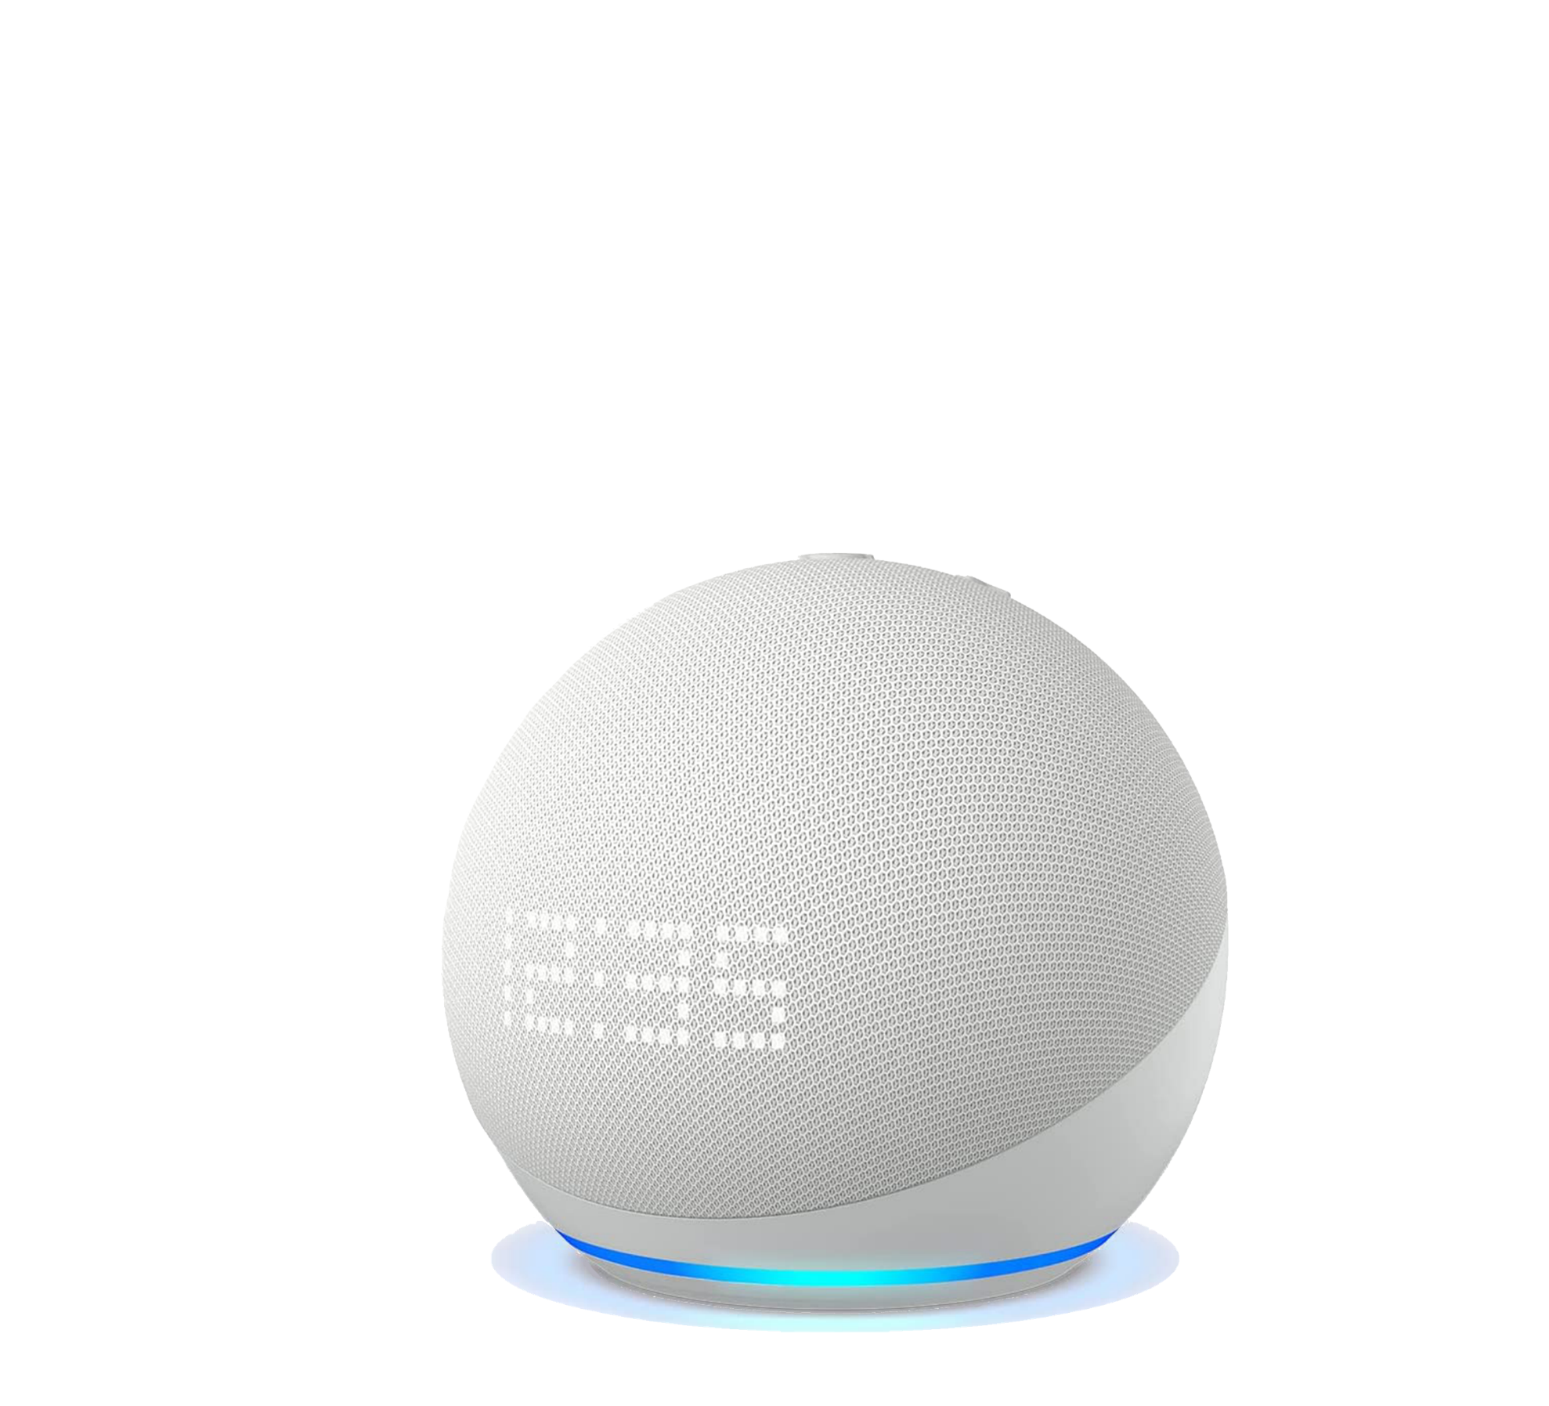
Next time, we’ll…
Generate ideas for how we could use Alexa for Good.
Use computational thinking to plan how our idea could become a new Alexa skill.
Use a simple online tool to program our intent and tell
Alexa what utterances to listen out for.
How could you use Alexa for Good?
19

